Slide 1
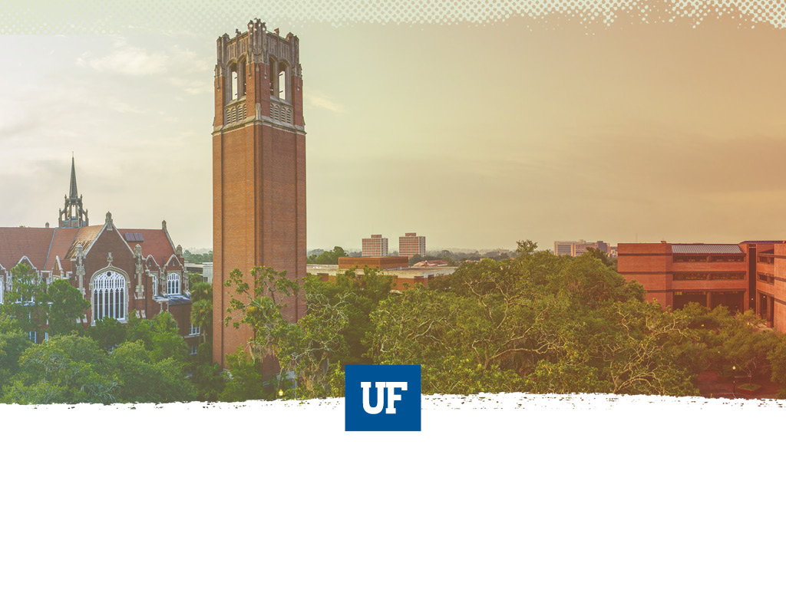
UF Quest: Student Town Hall
Pugh Hall, Ocora
March 30, 2017
SACUA Student Advisory Council for Undergraduate Affairs

Slide 2
UF Quest: Student Town Hall
Background, Development, and Path Ahead
Angela S. Lindner Associate Provost for Undergraduate Affairs

Slide 3

2010 Task Force on Undergraduate Education
Work towards creation of a signature experience for FTIC students with themed approach and electronic portfolios
Use themed signature program to develop specific leadership opportunities for juniors and seniors
Increase opportunities for experiential learning
Assist development of, promotion of, oversight of, and accountability for interdisciplinary, creative and research-oriented studies
Incorporate service learning and civic engagement goals into theme-based curriculum
Increase role of First-Year Florida
Create a co-curricular transcript for students
Re-examine the purpose of general education curriculum

Slide 4
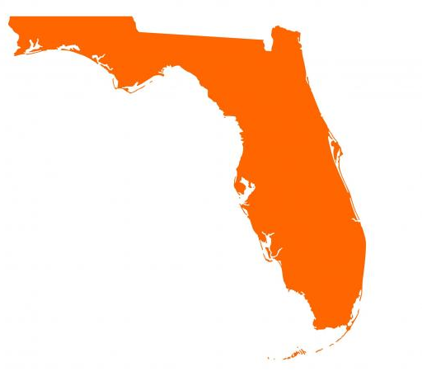
Opportunity for a Pre-eminent Shared Undergraduate Experience in Florida SUS
“In order to provide a jointly shared educational experience, a university that is designated a preeminent state research university may require its incoming first-time-in-college students to take a 9-to-12- 6-credit set of unique courses specifically determined by the university and published on the university’s website. The university may stipulate that credit for such courses may not be earned through any acceleration mechanism…or any other transfer credit.”
Florida Statute 1001.7065, 2013, 2016

Slide 5
Common Attributes of “Shared” Academic Experiences
Intellectually unifying
Sustained engagement with significant texts and enduring human questions
Can have shared readings, issues, and assignments
Can have shared signature experiences
Shared subset of student learning outcomes

Slide 6
Case for a Shared
Academic Experience
Cohort bonding among students and sense of belonging to a scholarly community
Enhanced awareness of the value of general education
Transitioning to the rigor of university coursework
Exposure to critical analysis, complex thinking, self-reflection, communication, decision-making, and other foundational content inherent in general education
Sequentially linked courses reinforce content knowledge and cognitive skills
Increased retention through inclusion of high-impact academic practices

Slide 7
Initial UF “Core” Model
IUF1000: “What Is the Good Life?”
(H, 3 CH)
“The Challenge of Climate Change”
(B/P, 3 CH)
“An Informed Life: People and Data”
(S, 3 CH)
All FTIC students take all 3 courses
Total of 9 credit hours
In addition to other UF and statewide general education requirements
All courses completed within the first two years

Slide 8
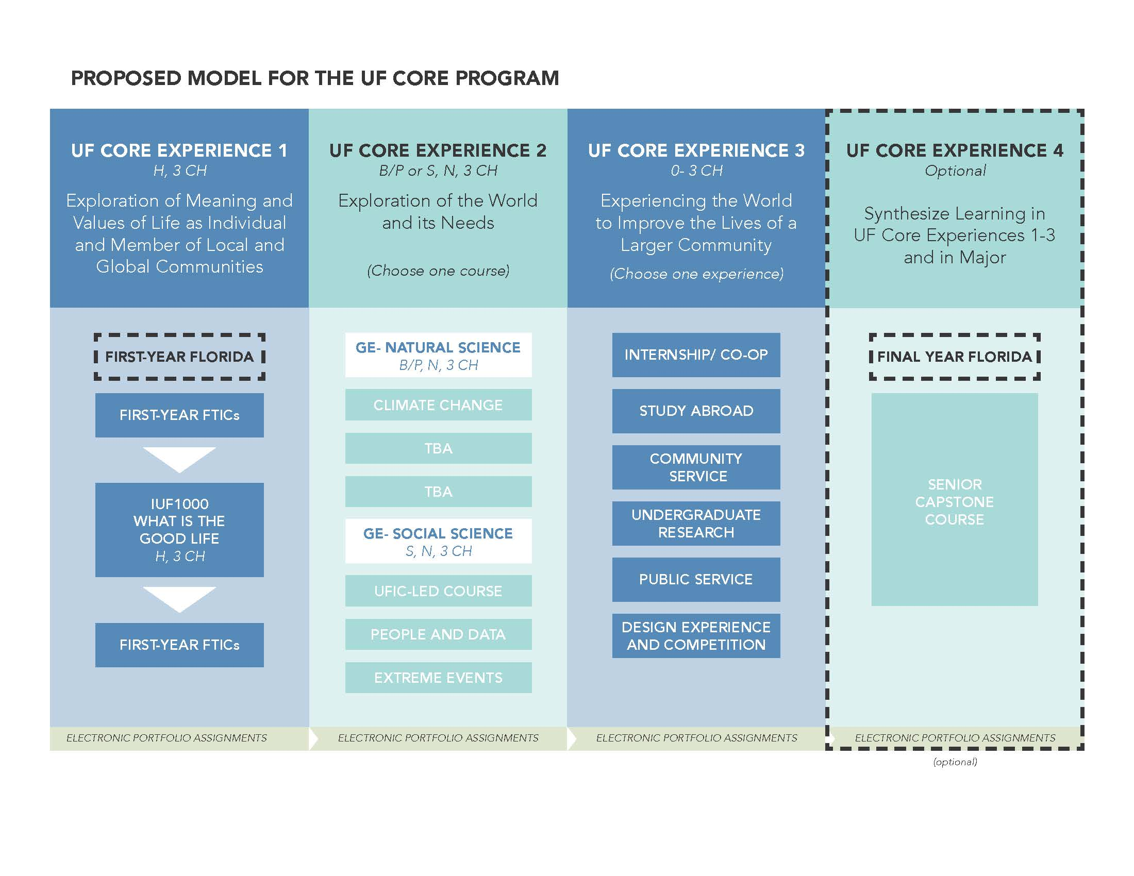

New Pathway: Spring 2016
Task Force 1 Chair:
Dr. Andy Wolpert, CLAS
Task Force 2 Chair:
Dr. David Miller, COE
Task Force 3 Chair:
Dr. Chris Hass, HHP
Task Force 4 Chair:
Dr. Elayne Colon, COE

Slide 9
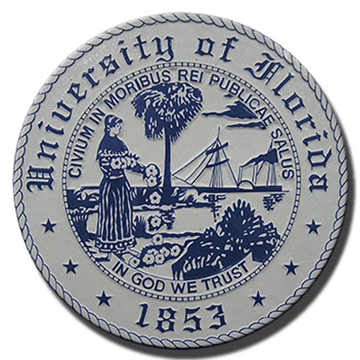
Student Engagement in UF Quest
SACUA
Task Force Representation
Student Town Hall
UF Quest Advisory Board Representation
UF Quest Curriculum Committee Representation
Logo Design: Maria Pitt, UF 2016

Slide 10
Timeline to Date

Slide 11
Timeline: Now Until Launch

Slide 12
Next Up in April: Final Proposed Framework
“…[humans], if they were ever to lose the appetite for meaning we call thinking and cease to ask unanswerable questions, would lose not only the ability to produce those thought-things that we call works of art but also the capacity to ask all answerable questions upon which every civilization is founded….” -Hannah Arendt

Slide 13

Angela Lindner
238 Tigert Hall
alindner@aa.ufl.edu

Slide 14
UF Quest: Student Town Hall
Experience 1 Courses
Dr. Andrew Wolpert XXX, Liberal Arts and Sciences

Slide 15
Original Model of UF Core Experience 1
One Course Option
  IUF 1000: What is the Good Life
  Central Theme: Meaning and Purpose
Common Experiences
Common Assignments
Common Readings

Slide 16
New Model of UF Core Experience 1
Multiple Course Options for Experience 1
  students can choose a UF Core 1 course according to their interests.
UF Core 1 Courses
  organized into five groups according to their themes to make it easier for students to select a UF Core 1 course according to their interests.
  explore essential questions about the human condition.
  share common objectives and learning outcomes.
  include some common experiential activities.
Next Step
  Receive feedback.
  Call for course proposals.
  Pilot multiple UF Core 1 courses.

Slide 17
UF Quest: Student Town Hall
Experience 2 Courses
Dr. David Miller Professor, Education

Slide 18
UF Quest: Student Town Hall
Experiential Learning Component
Dr. Chris Hass Associate Professor, HHP

Slide 19
UF Quest: Student Town Hall
E-Portfolio Task Force
Dr. Elayne Colon Director of Assessment and Accreditation, Education

Slide 20
Purpose of the ePortfolio
Facilitate the integration of student learning and connections made across coursework and experiences
Serve as evidence to demonstrate growth during students’ time at the university

Slide 21
Considerations and Next Steps
  July, 2016 – March, 2017
  Focused review on large scale implementation at universities
  Examined research and connected with several institutions to learn more about their processes, including Clemson, Duke, and Portland State
  Next Steps
  Consider platform
  Pilot with student groups

Slide 22
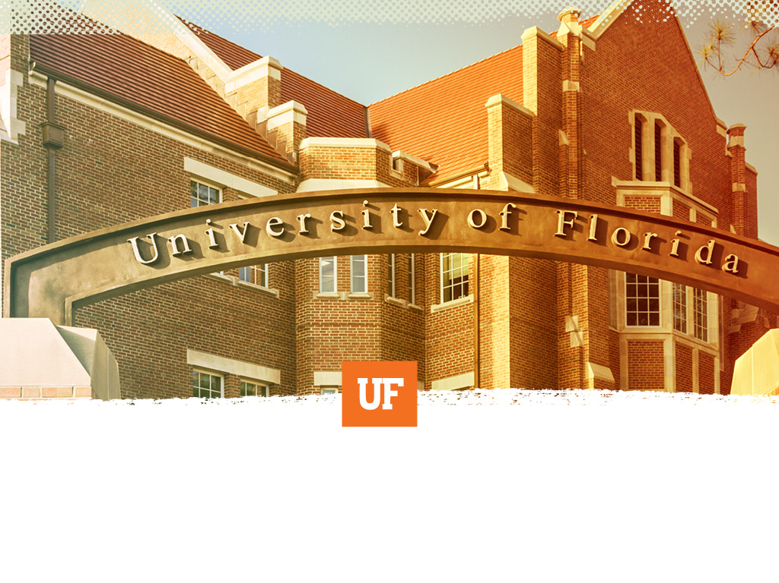
“To bridge means loosening our borders, not closing off to others.
Bridging is the work of opening the gate to the stranger, within and without….
To bridge is to attempt community, and for that we must risk being open to personal, political and spiritual intimacy…. ”
--Anzaldúa & Keating, 2002, This Bridge We Call Home, p. 3

