Slide 1

UF Quest: Faculty Mini-Retreat
Ustler Hall
April 3, 2017
Office of Undergraduate Affairs

Slide 2
UF Quest: Faculty Mini-Retreat
Proposed UF Quest Framework and Relevant Questions
Angela S. Lindner Associate Provost for Undergraduate Affairs

Slide 3

UF Quest Faculty Mini-Retreat
Present current proposed framework of UF Quest
Broaden college faculty participation in program development
Focus on questions to move us forward in program development
Describe and whet our appetite for next stages of program development
Logo Design: Maria Pitt, UF 2016

Slide 4
UF Quest Faculty Mini-Retreat Agenda
Introductions with Table Partners (11:05 AM)
Proposed Framework of UF Quest and Introduction to Today’s Focus Questions (11:10 AM)
Round 1: Responses to Specific Task Force Questions (11:30 AM)
Lunch and Response to Broad General Education Question (12:15 PM)
Round 2 Responses to Broad General Education Question (1:00 PM)
Brief Table Reports (1:30 PM)
Re-cap and Path Forward (1:45 PM)

Slide 5
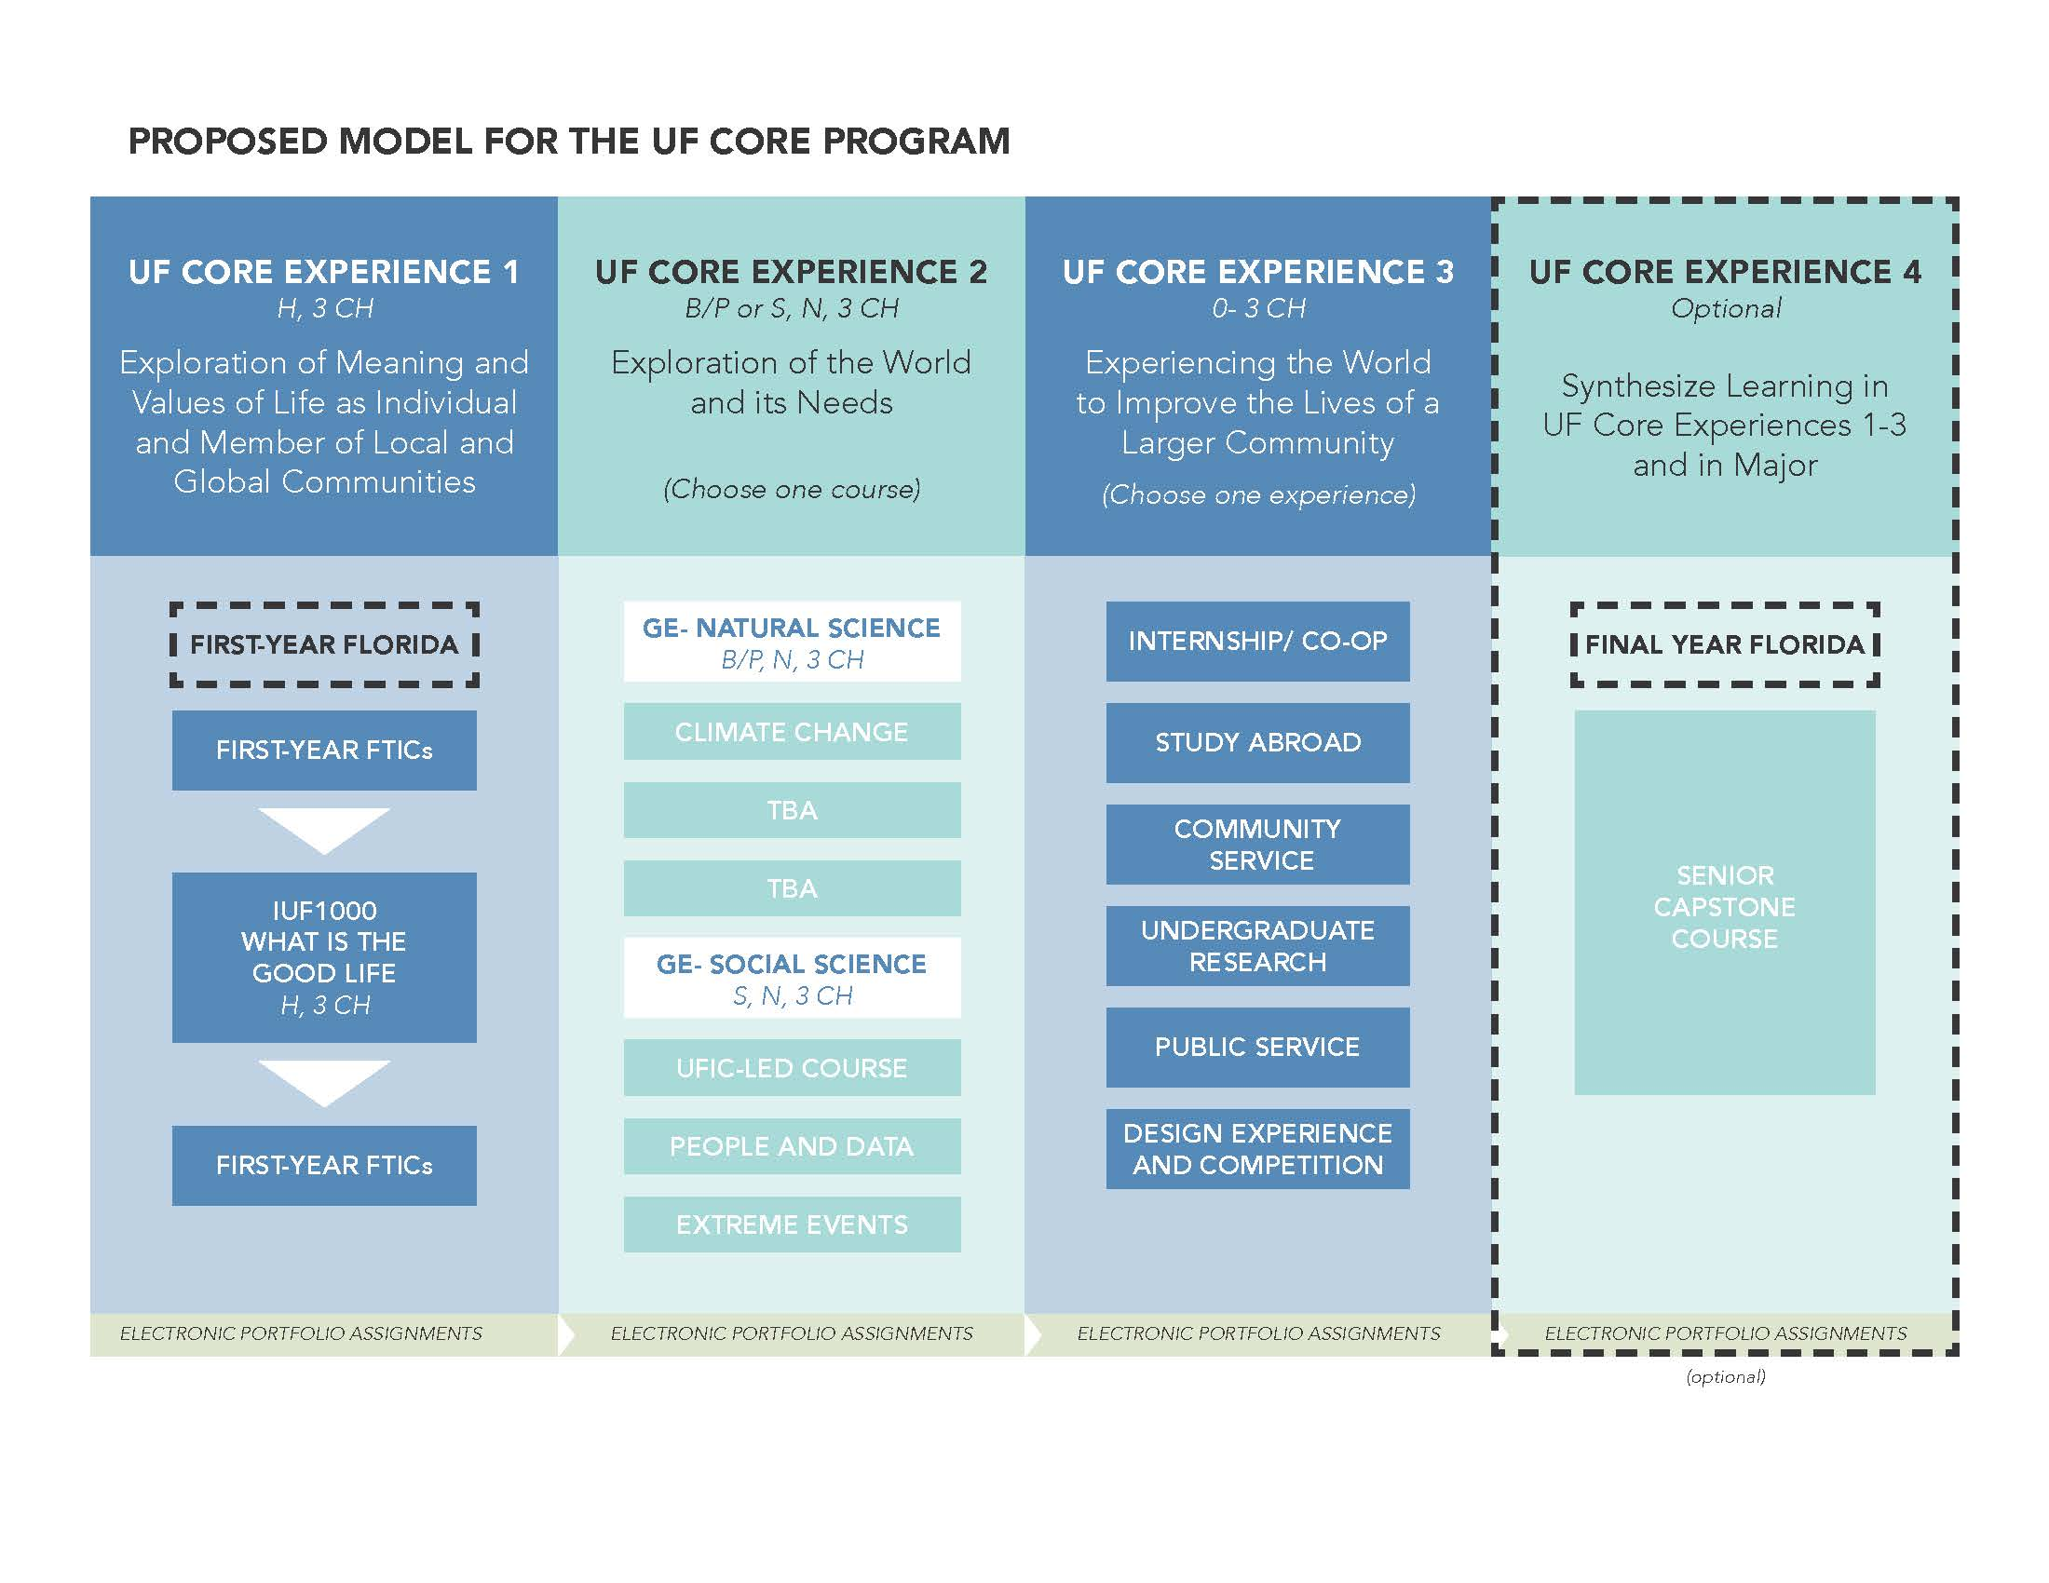

Starting Point: Spring 2016
Task Force 1 Chair:
Dr. Andy Wolpert, CLAS
Task Force 2 Chair:
Dr. David Miller, COE
Task Force 3 Chair:
Dr. Chris Hass, HHP
Task Force 4 Chair:
Dr. Elayne Colón, COE

Slide 6
“…[humans], if they were ever to lose the appetite for meaning we call thinking and cease to ask unanswerable questions, would lose not only the ability to produce those thought-things that we call works of art but also the capacity to ask all answerable questions upon which every civilization is founded….”
-Hannah Arendt

Slide 7
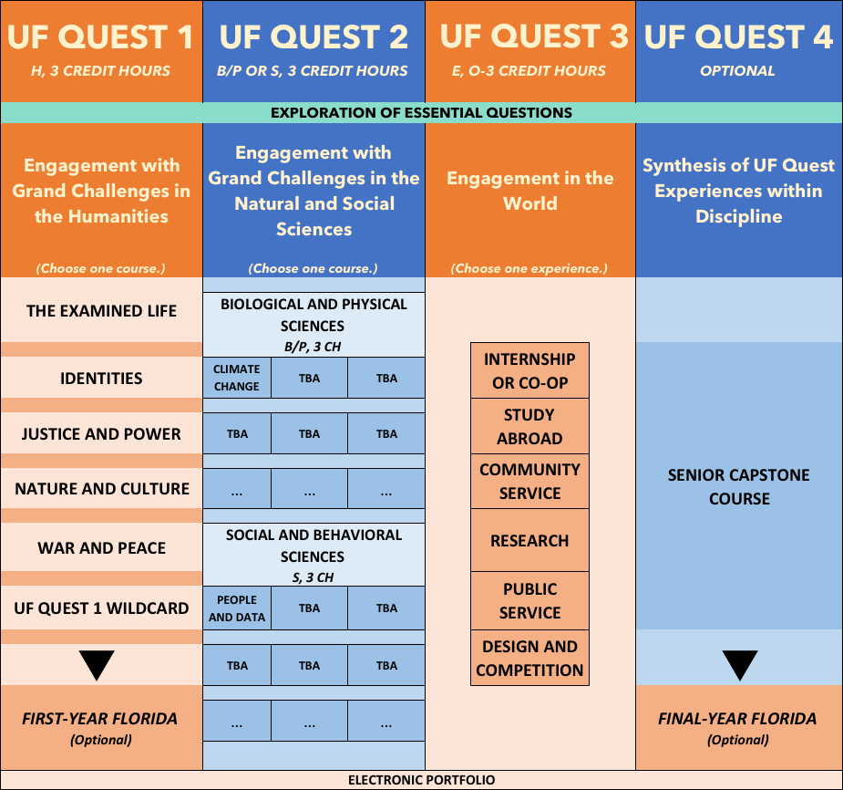
Final Proposed Model

Slide 8
UF Quest 1 Shared Student Learning
Outcomes
  Content: Identify, describe, and explain the history, underlying theory and methodologies used across humanities disciplines to understand essential questions addressed in a particular UF Quest 1 theme.
  Critical Thinking: Analyze and evaluate answers to essential questions addressed in a particular UF Quest 1 theme by using established resources drawn from humanities disciplines.
  Communication: Communicate clearly and effectively answers to essential questions addressed in a particular UF Quest 1 theme in written and oral forms as appropriate to the relevant humanities disciplines.

Slide 9
UF Quest 2 Shared Student Learning Outcomes
  Describe and explain the cross-disciplinary aspects of a pressing societal problem or challenge.
  Propose and critically analyze an approach, policy, or action (grounded in theories, methodologies, and data) that addresses some aspect of a pressing societal problem or challenge.
  Present the proposed approach, policy, or action to the pressing societal problem or challenge to a general audience.

Slide 10
UF Quest 3 Shared Student Learning Outcomes for Design Experiences
Design
Students design or create an original system, component, form or work that meets the desired needs within reasonable parameters and constraints of the discipline or profession.
Content: Students utilize terminology, concepts, ethical practices, theories, and methodologies relevant to the design process.
Communication: Students communicate knowledge, ideas, and reasoning clearly and effectively in forms appropriate to the design experience.
Critical Thinking: Students analyze information carefully and logically from multiple perspectives and develop reasoned solutions relevant to the design experience.
Students explore the significance of their design experience through reflection, critical analysis, synthesis, and discussion.
Students identify, describe, and explain how the experience informed their sense of self and discipline.
Students analyze themes, conflicts, and issues that emerged and describe how they were addressed.
Students identify, describe, and explain the connection between the discipline or course content and the design or creative activity.
Students describe and explain how the design experience will modify and/or support future behaviors, attitudes, and career development.

Slide 11
Basic Understandings
Fall 2018 pilot and Fall 2019 launch
Courses in UF Quest 1 and UF Quest 2 must all be multi-disciplinary in nature.
  They can be offered by one program or by multiple colleges.
  While not required, some courses will have N or D General Education designations.
  Ideally, UF Quest 2 bridges with UF Quest 1 via assignments, reflections, etc. and the ePortfolio.
UF Quest 3 will offer a new General Education designation, E.
All colleges must have experiences available to students in Fall 2019 for UF Quest 3. UF Quest 3 will be optional for students, however, in Years 1-6 to allow phase in for all students. Required of all students in Year 7 if Year 6 evaluation recommends so.
Six-year cycle. Mid-cycle evaluation in Year 3. Full evaluation in Year 6. Refreshing of themes in Year 7.

Slide 12
Roll Up Your Shirtsleeves!
During Rounds 1 and 2 (before and after lunch):
  Tables 1 and 5 will focus on UF Quest 1 (Task Force 1).
  Tables 2 and 6 will focus on UF Quest 2 (Task Force 2).
  Tables 3 and 7 will focus on UF Quest 3 (Task Force 3).
  Tables 4 and 8 will focus on ePortfolio component of UF Quest (Task Force 4).
During lunch, all tables will focus on the Broad General Education Question (the last question on each Task Force Questions handout):
  How can UF and UF Quest shepherd students into an increased appreciation and valuing of general education in their overall education regardless of their major or career choice?
For each table, assign a recorder and a discussion leader.
Feel free to use the large poster papers to record responses or 8 ½” x 11”-inch paper provided.

Slide 13
Re-Cap: Summary of Common Themes in Responses

Slide 14
Timeline: Now Until Launch

Slide 15

Angela Lindner
238 Tigert Hall
alindner@aa.ufl.edu

Slide 16

“To bridge means loosening our borders, not closing off to others.
Bridging is the work of opening the gate to the stranger, within and without….
To bridge is to attempt community, and for that we must risk being open to personal, political and spiritual intimacy…. ”
--Anzaldúa & Keating, 2002, This Bridge We Call Home, p. 3

