Slide 1

UF Quest: Faculty Senate Presentation 2
New Proposed Model
Angela S. Lindner Associate Provost for Undergraduate Affairs

Slide 2


Faculty Senate Presentations
March Meeting
  Background on pre-eminence program for undergraduates
  Actions to date
  Process for unfolding a full program
April Meeting
  Final proposed framework for UF Quest
May Meeting
  Summary of faculty feedback and responses
  Request for Senate support of UF Quest
Logo Design: Maria Pitt, UF 2016

Slide 3
Case for a Shared
Academic Experience
Cohort bonding among students and sense of belonging to a scholarly community
Enhanced awareness of the value of general education
Transitioning to the rigor of university coursework
Exposure to critical analysis, complex thinking, self-reflection, communication, decision-making, and other foundational content inherent in general education
Sequentially linked courses reinforce content knowledge and cognitive skills
Increased retention through inclusion of high-impact academic practices

Slide 4
Summary: Evolution of UF Quest
Catalyst for a shared academic experience for FTIC students:
  2010 Task Force on Undergraduate Education
Connection to UF Pre-eminence:
  2013 Legislation (Florida Statute 1001.7065)
IUF 1000 (“What Is the Good Life?”) established as first pillar
First full model featured three required courses, IUF1000 (H), Climate Change (B/P), People and Data (S), totaling to 9 credits.
IUF1000: “What Is the Good Life?”
(H, 3 CH)
“The Challenge of Climate Change”
(B/P, 3 CH)
“An Informed Life: People and Data”
(S, 3 CH)

Slide 5
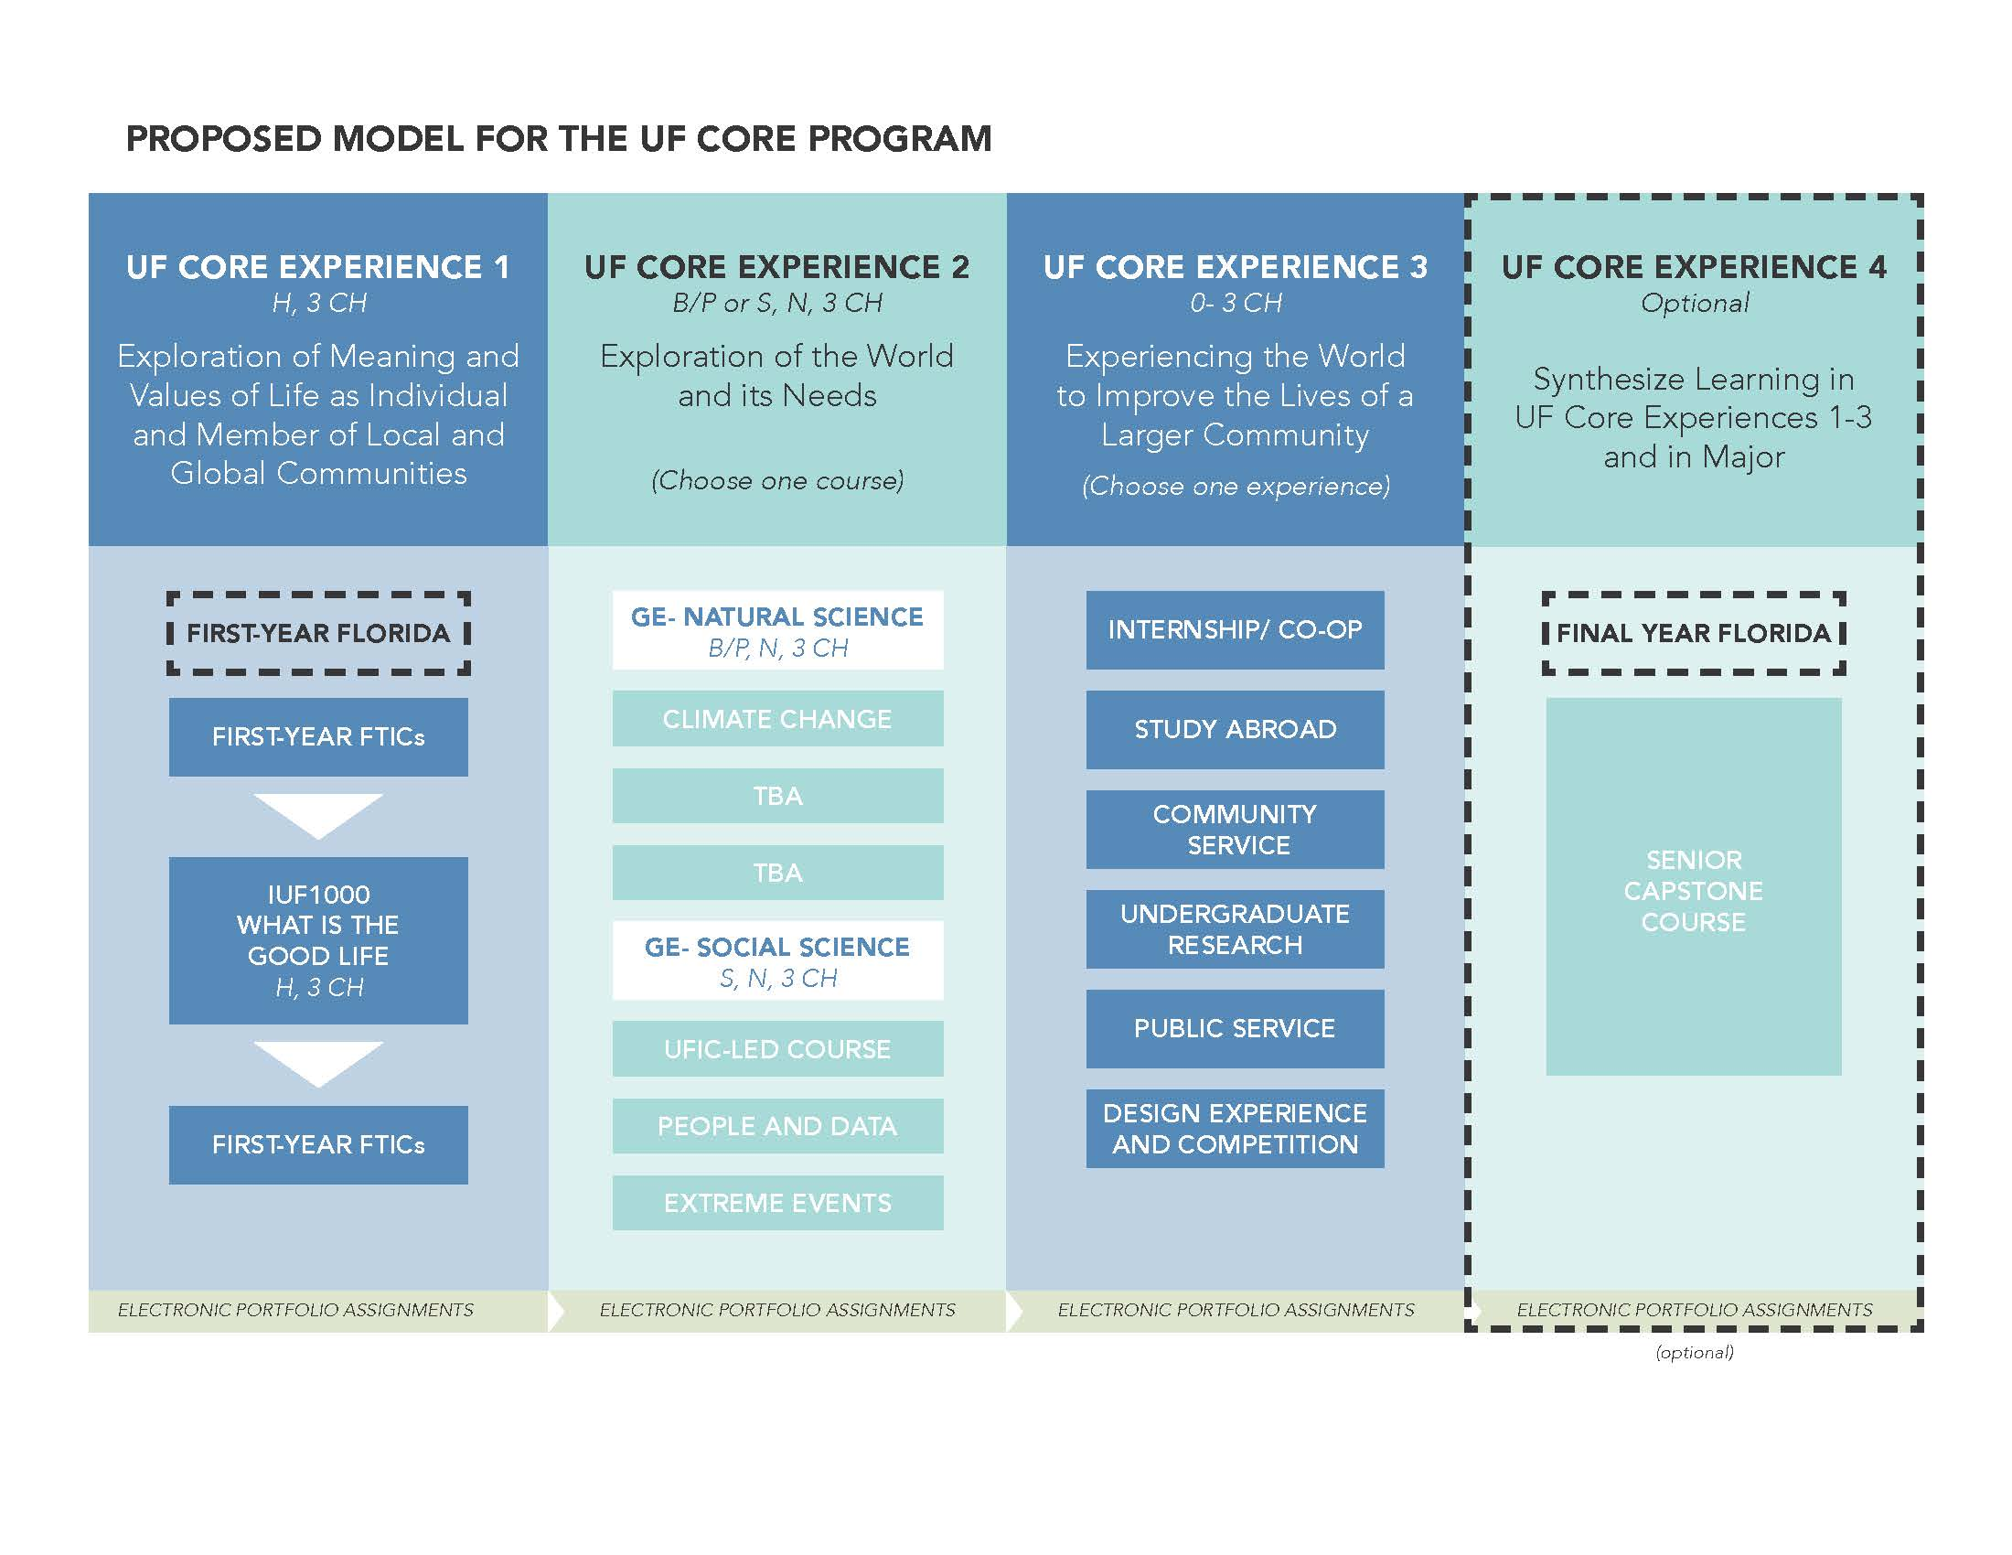

New Model Proposed: Spring 2016
Task Force 1 Chair:
Dr. Andy Wolpert, CLAS
Task Force 2 Chair:
Dr. David Miller, COE
Task Force 3 Chair:
Dr. Chris Hass, HHP
Task Force 4 Chair (Eportfolio):
Dr. Elayne Colon, COE

Slide 6
Final Proposed Framework:
Engaging Students in Essential and Pressing Questions in the World
“…[humans], if they were ever to lose the appetite for meaning we call thinking and cease to ask unanswerable questions, would lose not only the ability to produce those thought-things that we call works of art but also the capacity to ask all answerable questions upon which every civilization is founded….” -Hannah Arendt

Slide 7
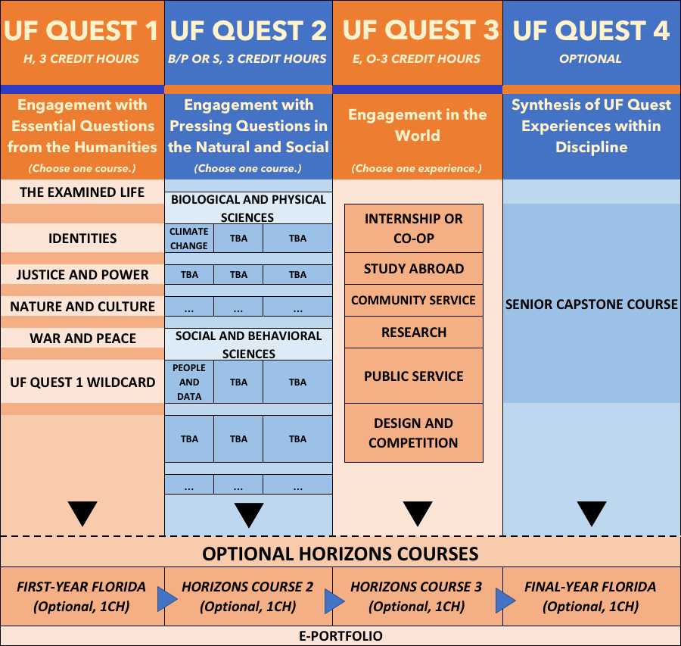
Final Proposed Model

Slide 8
UF Quest 1 Essential Questions
The Examined Life:
  What makes life worth living? How do we or should we examine a life? What is valuable in life?
Identities:
  How are personal and social identities constructed? How and why do they change? In what ways are such identities personally, socially, or politically significant?
Justice and Power:
  What is justice? How are just societies created and maintained? How are the uses and abuses of power connected with justice and injustice?
Nature and Culture:
  Who are we in relation to the natural world? How have humans understood their role in the natural world and their responsibility to it? How do portrayals of nature reflect our values or self-understanding?
War and Peace:
  What is the nature of human conflict, whether it is physical or confined to words and ideas? How can communities manage, resolve, and remember conflicts?

Slide 9
UF Quest 2 Pressing Questions
Describe and explain the cross-disciplinary aspects of a pressing societal problem or challenge
Propose and critically analyze an approach, policy, or action (grounded in theories, methodologies, and data) that addresses some aspect of a pressing societal problem or challenge
Present the proposed approach, policy, or action to the pressing societal problem or challenge to a general audience

Slide 10
Basic Understanding in Moving Forward
Fall 2018 pilot and Fall 2019 launch
Courses in UF Quest 1 and UF Quest 2 must all be multi-disciplinary in nature.
  They can be offered by one program or by multiple colleges.
  While not required, some courses will have N or D General Education designations.
  Ideally, UF Quest 2 bridges with UF Quest 1 via assignments, reflections, etc. and the ePortfolio.
A new General Education designation, E, is recommended for UF Quest 3.
All colleges must have experiences available to students in Fall 2019 for UF Quest 3. UF Quest 3 will be optional for students, however, in Years 1-6 to allow phase in for all students. Required of all students in Year 7 if Year 6 evaluation recommends so.
Six-year cycle. Mid-cycle evaluation in Year 3. Full evaluation in Year 6. Refreshing of themes in Year 7.

Slide 11
Implementation Timeline
UF Quest Launches
Fall 2019

Slide 12
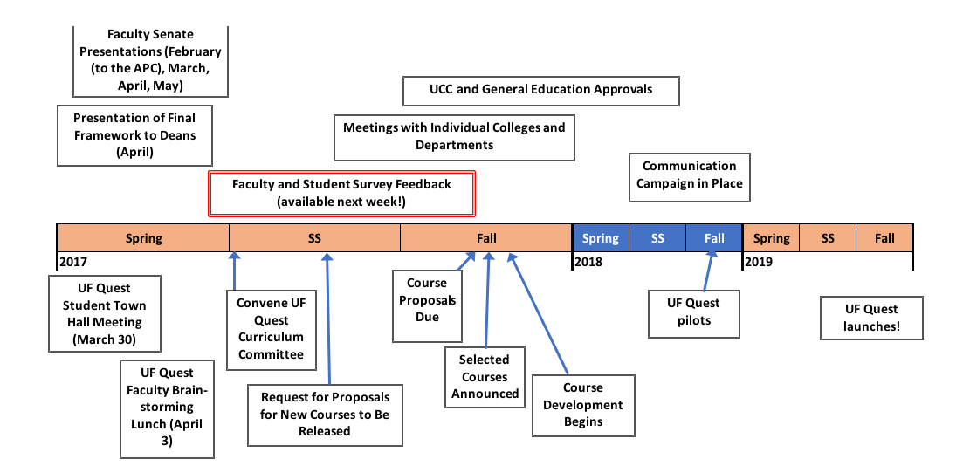
Timeline: Now Until Launch

Slide 13

Angela Lindner
238 Tigert Hall
alindner@aa.ufl.edu

