Slide 1
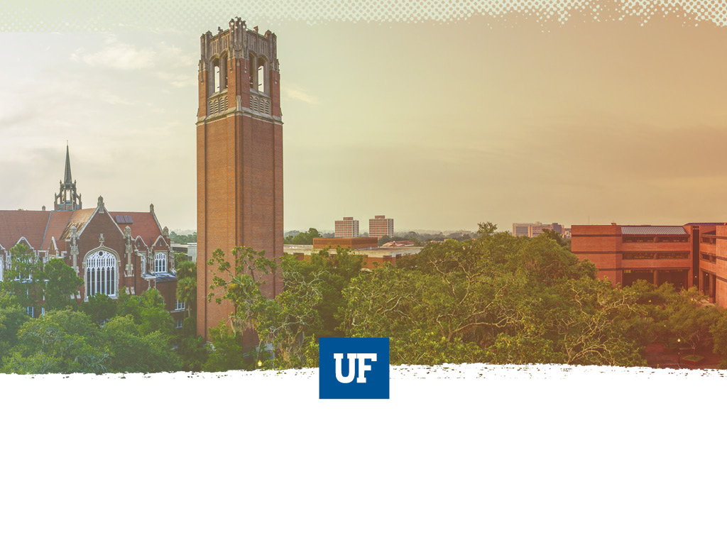
UF Quest: Faculty Senate Presentation 1
Background and Process
Angela S. Lindner Associate Provost for Undergraduate Affairs

Slide 2


Faculty Senate Presentations
March Meeting
  Background on pre-eminence program for undergraduates
  Actions to date
  Process for unfolding a full program
April Meeting
  Final proposed framework for UF Quest
May Meeting
  Summary of faculty feedback and responses
  Request for Senate support of UF Quest
Logo Design: Maria Pitt, UF 2016

Slide 3
2010 Task Force on Undergraduate Education
Work towards creation of a signature experience for FTIC students with themed approach and electronic portfolios
Use themed signature program to develop specific leadership opportunities for juniors and seniors
Increase opportunities for experiential learning
Assist development of, promotion of, oversight of, and accountability for interdisciplinary, creative and research-oriented studies
Incorporate service learning and civic engagement goals into theme-based curriculum
Increase role of First-Year Florida
Create a co-curricular transcript for students
Re-examine the purpose of general education curriculum

Slide 4
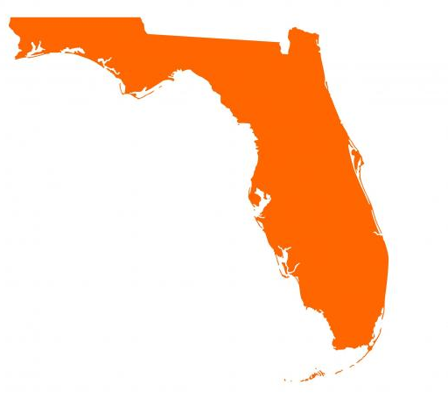
Opportunity for a Pre-eminent Shared Undergraduate Experience in Florida SUS
“In order to provide a jointly shared educational experience, a university that is designated a preeminent state research university may require its incoming first-time-in-college students to take a 9-to-12- 6-credit set of unique courses specifically determined by the university and published on the university’s website. The university may stipulate that credit for such courses may not be earned through any acceleration mechanism…or any other transfer credit.”
Florida Statute 1001.7065, 2013, 2016

Slide 5
Common Attributes of “Shared” Academic Experiences in General Education
Intellectually unifying
Sustained engagement with significant texts and enduring human questions
Can have shared readings, issues, and assignments
Can have shared signature experiences
Shared subset of student learning outcomes

Slide 6
Case for a Shared
Academic Experience
Cohort bonding among students and sense of belonging to a scholarly community
Enhanced awareness of the value of general education
Transitioning to the rigor of university coursework
Exposure to critical analysis, complex thinking, self-reflection, communication, decision-making, and other foundational content inherent in general education
Sequentially linked courses reinforce content knowledge and cognitive skills
Increased retention through inclusion of high-impact academic practices

Slide 7
Initial UF “Core” Model
IUF1000: “What Is the Good Life?”
(H, 3 CH)
“The Challenge of Climate Change”
(B/P, 3 CH)
“An Informed Life: People and Data”
(S, 3 CH)
All FTIC students take all 3 courses
Total of 9 credit hours
In addition to other UF and statewide general education requirements
All courses completed within the first two years

Slide 8
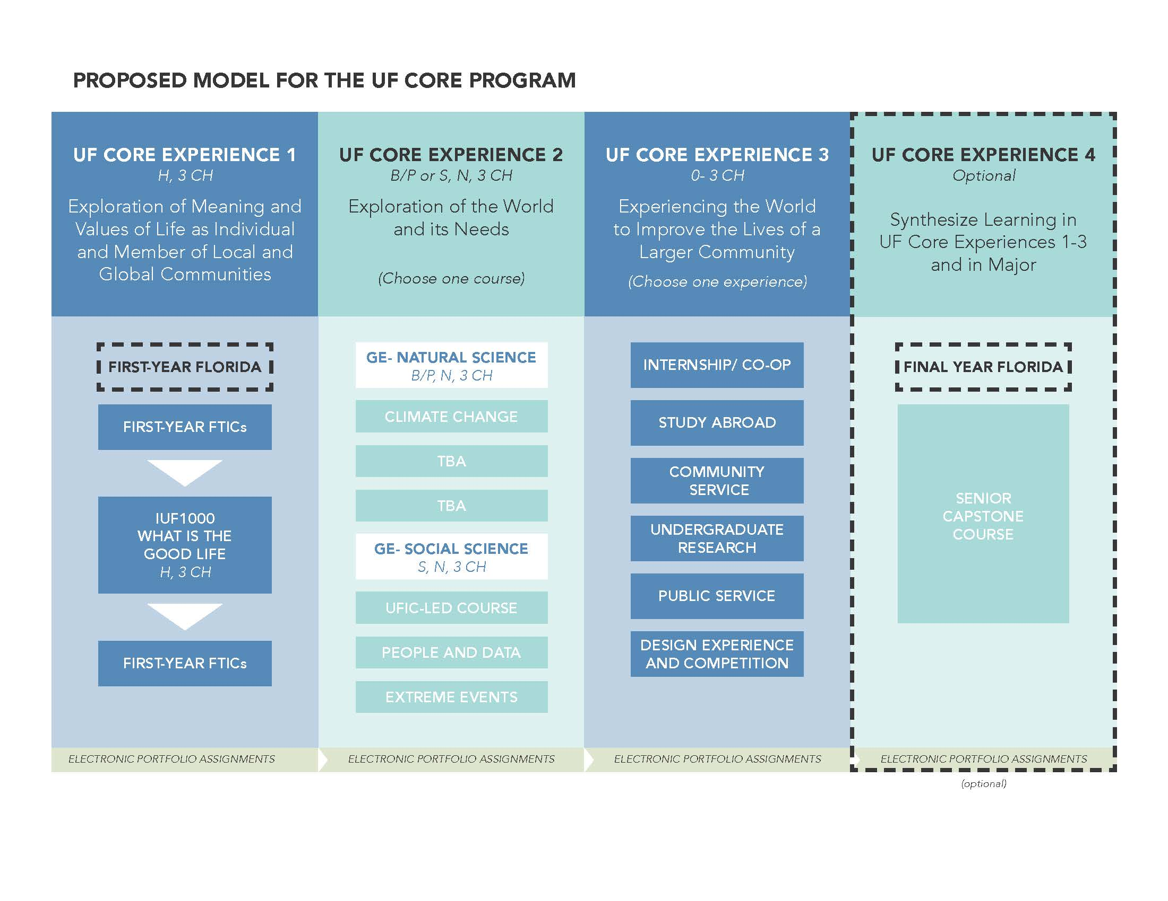

New Pathway: Spring 2016
Task Force 1 Chair:
Dr. Andy Wolpert, CLAS
Task Force 2 Chair:
Dr. David Miller, COE
Task Force 3 Chair:
Dr. Chris Hass, HHP
Task Force 4 Chair:
Dr. Elayne Colon, COE

Slide 9
Timeline to Date

Slide 10
Timeline: Now Until Launch

Slide 11
Next Up in April: Final Proposed Framework
“…[humans], if they were ever to lose the appetite for meaning we call thinking and cease to ask unanswerable questions, would lose not only the ability to produce those thought-things that we call works of art but also the capacity to ask all answerable questions upon which every civilization is founded….” -Hannah Arendt

Slide 12

Angela Lindner
238 Tigert Hall
alindner@aa.ufl.edu

Slide 13
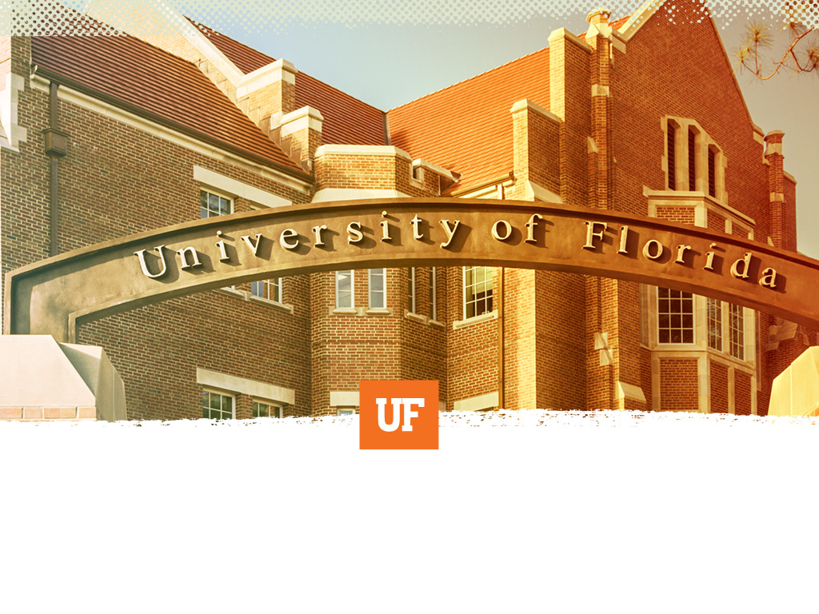
“To bridge means loosening our borders, not closing off to others.
Bridging is the work of opening the gate to the stranger, within and without….
To bridge is to attempt community, and for that we must risk being open to personal, political and spiritual intimacy…. ”
--Anzaldúa & Keating, 2002, This Bridge We Call Home, p. 3

