Slide 1

UF Quest: Faculty Senate Presentation 3
Request for Feedback and Steps Forward
Angela S. Lindner Associate Provost for Undergraduate Affairs

Slide 2


Faculty Senate Presentations
March Meeting
  Background on pre-eminence program for undergraduates
  Actions to date
  Process for unfolding a full program
April Meeting
  Final proposed framework for UF Quest
May Meeting
  Summary of faculty feedback and responses
  Request for Senate support of UF Quest
Logo Design: Maria Pitt, UF 2016

Slide 3
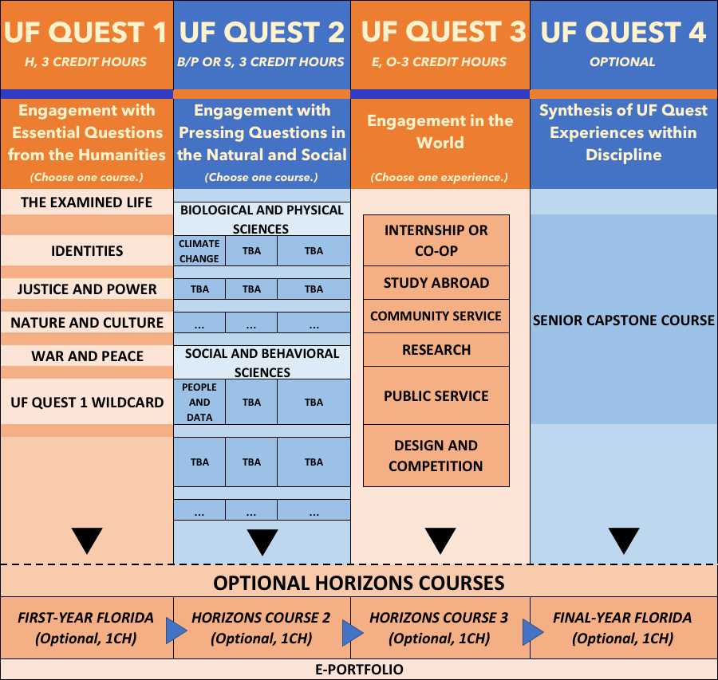
Final Proposed Model

Slide 4
Purpose of Today’s Presentation
Outline next steps in filling in the framework of UF Quest
Provide initial responses to early feedback from faculty
Request constructive feedback
Outline faculty engagement opportunities

Slide 5
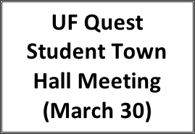

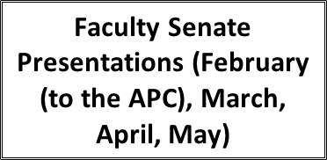





















Next Steps and Timeline

Slide 6
Faculty Input to Date
Four Task Forces (Spring 2016-present)
  Task Force 1: 11 faculty (CLAS, COTA, CALS, DCP, HWCOE)
  Task Force 2: 7 faculty (COE, CLAS, CALS)
  Task Force 3: 6 faculty (HHP, CLAS, PHHP, COE)
  Task Force 4: 8 faculty (COE, COTA, Libraries, CLAS, HWCOE)
COTA Faculty Retreat (September 2016)
UF Quest Conference (November 2016)
  38 faculty (CLAS, CALS, HHP, PHHP, COTA, HWCOE, DCP, COE, JOUCO, Dentistry, Nursing)
CLAS Faculty Council (November 2016)
University Curriculum Committee, General Education Committee discussions
Advisory Council for Undergraduate Affairs discussions
Combined Working Groups (Spring 2017)
  9 faculty added to Task Forces 1 and 2 (CLAS)
Faculty Retreat (March 2017)
  31 faculty (CLAS, HWCOE, COTA, CALS, COE, CJC, PHHP, COTA, COB, DCP)
Academic Policy Council Presentation (February 2017)
Survey (May 5-present)

Slide 7
Initial Feedback from Survey of Faculty
Number of respondents: 33
Colleges: CLAS, HWCOE, Pharmacy, PHHP, COM, CJC

Slide 8
Initial Faculty Survey Comments: 7 Questions
Do you believe that the proposed UF Quest framework honors the recommendations provided by the UF Undergraduate Task Force in 2010?
Do you believe that the proposed UF Quest framework honors the vision and mission of undergraduate education at UF?
Can you suggest approaches to be included in UF Quest to provide students the opportunity to be guided by the following core values put forward by the 2010 UF Undergraduate Education Task Force: Creativity, Diversity, Engagement, Intellectual Curiosity, Leadership, and Responsibility?
What do you perceive to be the benefits of the proposed UF Quest program for our students?
What are your primary concerns about the proposed UF Quest program?
Please suggest any improvement to the proposed UF Quest framework.
Please include any additional constructive comments about the UF Quest program that may be helpful in the development and implementation stages of the program.

Slide 9
Observations and Identified Challenges
Observations
Challenges
Soft-core, course fluff, over-determined, watered-down, top-down, narrowly focused
Opportunities to help students mature, have high awareness of civic involvement, critically think, write at the collegiate level, see interdisciplinary approaches, bonding with faculty and campus, explore topics of interest, be well-rounded, be prepared for career, unique UF experience, to be better than we are, in self-analysis and growth
Establishes opportunity to force students to “leave home” and adopt new perspectives
Inspiring and engaging students, rather than the opposite
Cooperation at all levels
Protecting departmental resources and the humanities
Protecting students in programs with already high total credit hours
Ensuring appropriate faculty expertise

Slide 10
Desired Elements
Serve as a platform for a diverse, broad-based, engaged liberal arts education
Outcomes: independent and critical thinkers, strong communicators, close readers, innovative, flexible, skilled in careful argumentation and proof
Flexibility for students and faculty (broad and diverse set of courses; availability of sections; focus on common experience, not common content of courses)
Courses: Customized (no common syllabus), seminar-type, small size (faculty-student engagement), rigorous, some taught in foreign language, models of excellence in teaching quality and techniques
Most experienced faculty trained in the specific discipline(s) of the course
Ability to refresh courses
Intentional mentoring
Introduction to UF library system

Slide 11
Forthcoming Faculty Senate Engagement
Survey open to all faculty through Fall 2017: https://ufl.qualtrics.com/jfe/form/SV_bBezLuxgHONq2QR
Password: UFQuestFaculty
Inclusion on Academic Policy Council meetings’ agenda in the Fall 2017/Spring 2018
Quest Curriculum Sub-Committee (Summer 2017)
  Shaping and submission of the final request for proposals (Summer 2017)
  Selection of courses (Fall 2017)
  Evaluation of quality of courses in partnership with GEC (Fall 2018ff)
  Evaluation of program in Year 6 and refreshing themes/courses (Fall 2018 ff)
Return to Faculty Senate after courses have been selected (November, December)
UCC and GEC approvals

Slide 12

Angela Lindner
238 Tigert Hall
alindner@aa.ufl.edu

